Slide 1
The Farming Life Centre is a charitable organisation which provides a range of business and health related support to the farming and rural community of the Derbyshire and Staffordshire Peak District.
In all its work the Centre seeks to improve the quality of life of farmers and their families, by promoting personal, social and economic well-being.

Slide 2
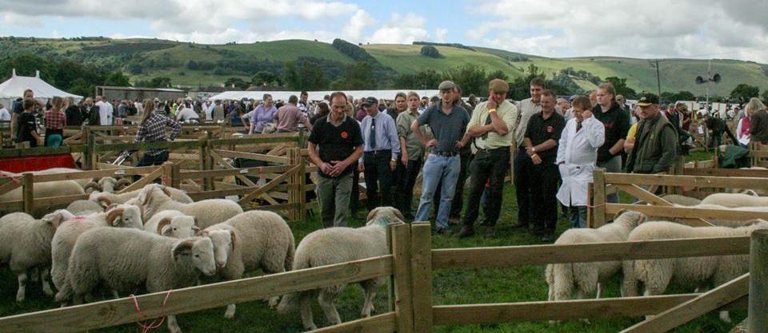
Our Purpose
The Farming Life Centre’s strategy has focused on developing a range of projects and services to address the health, social and economic inequalities and deprivation within the Peak District upland farming community.

Slide 3
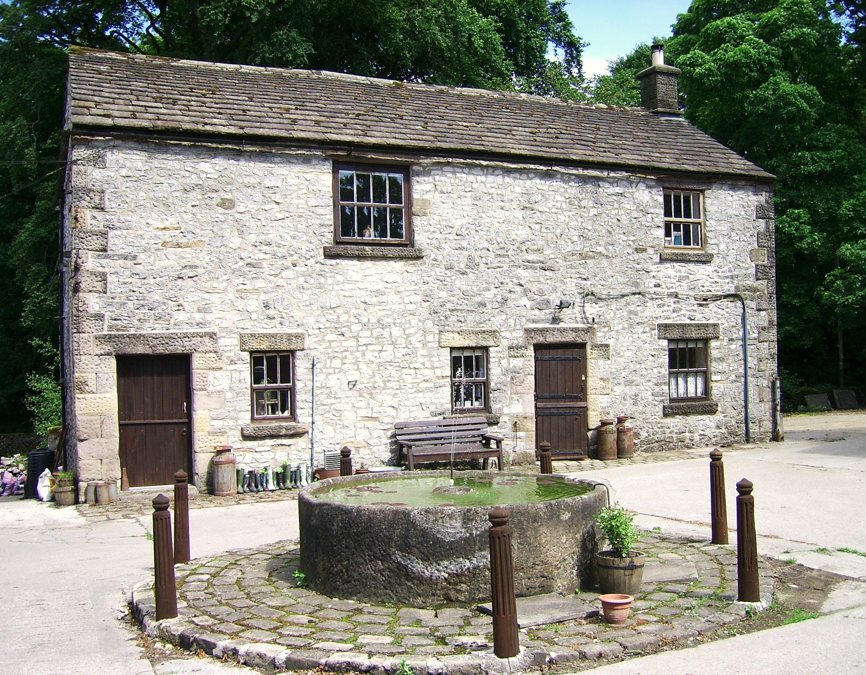
Our facilities
Our base in the former stable block at Blackwell Hall Farm has two meeting rooms which are regularly used for social gatherings, project meetings, practical workshops, therapeutic activities, training events and meetings of Buxton Young Farmers’ Club.

Slide 4
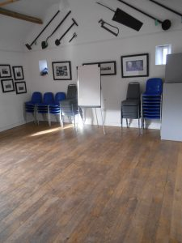
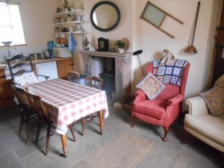
A meeting place
The Centre has also developed a strong identity as a unique community facility – a meeting place on a farm, where farmers are understood and can feel valued and at home We rent out our meeting rooms to raise valuable income

Slide 5
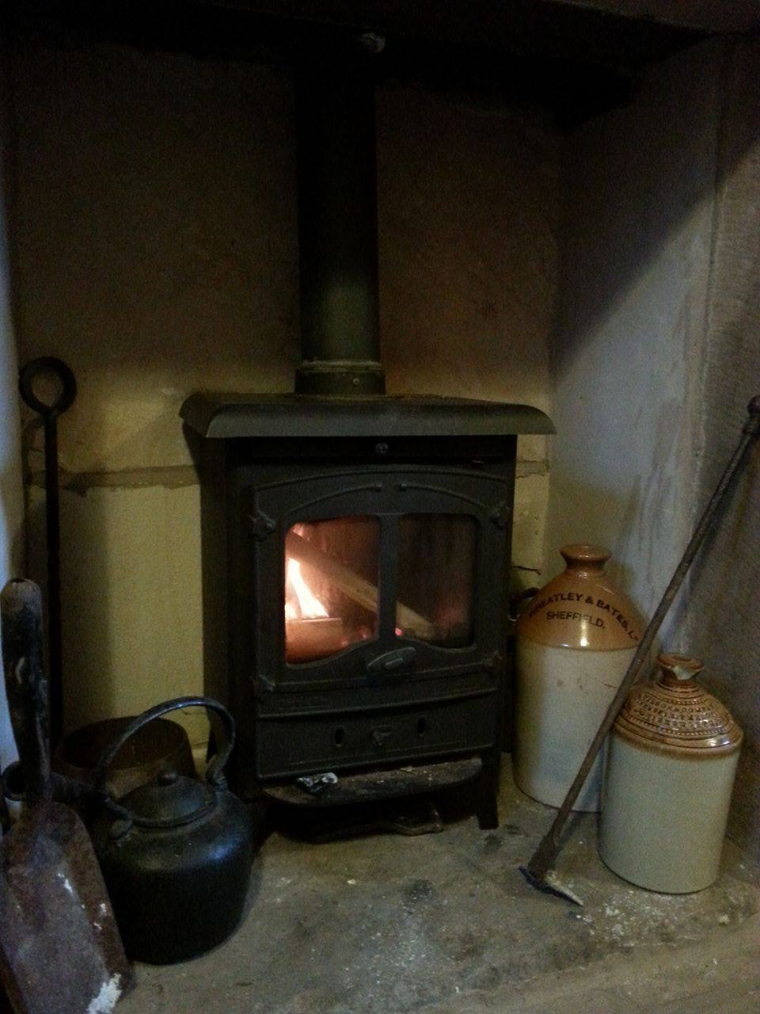
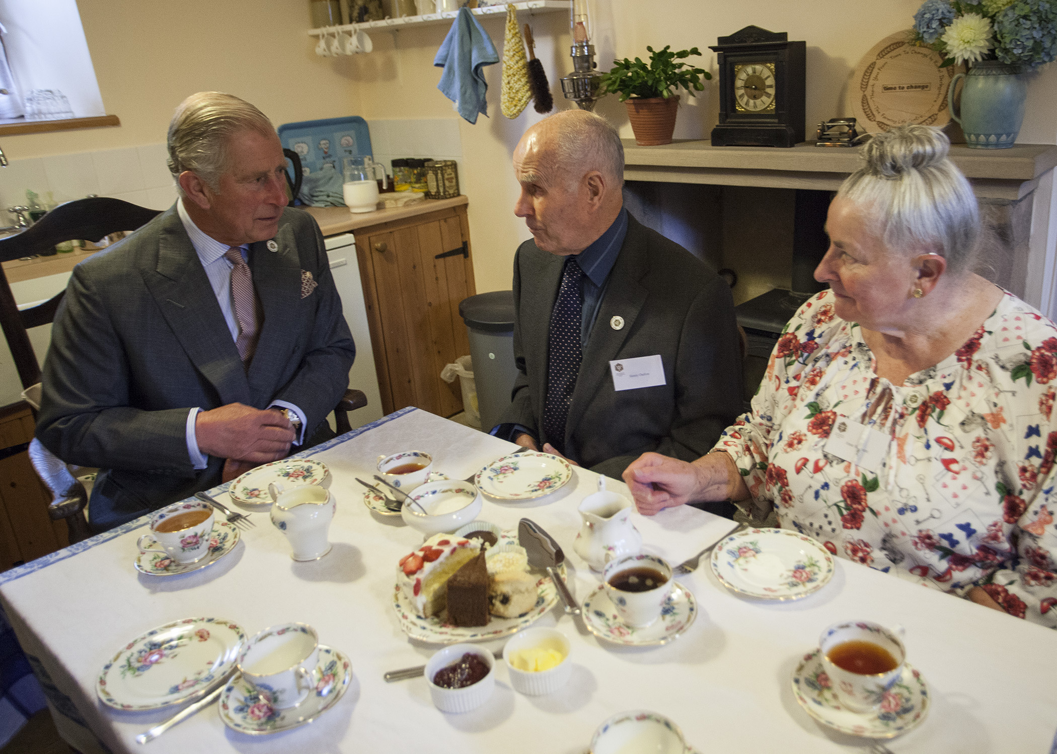
A warm welcome
Our “reminiscence kitchen” which is a 1950’s style farmhouse kitchen and is the social hub of the building.
Our “reminiscence kitchen” which is a 1950’s style farmhouse kitchen and is the social hub of the building.

Slide 6
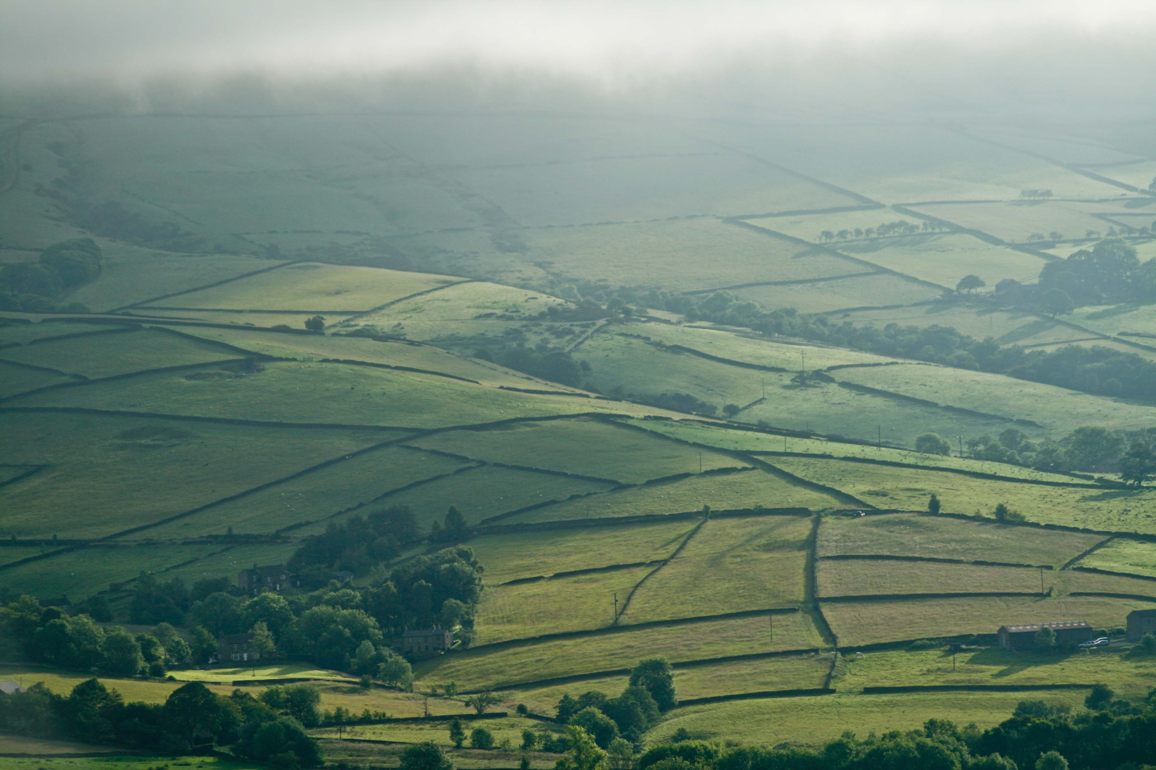
Our services and projects Poor health leads to poor business, and poor business leads to poor health.
Designed to mesh together, provide timely business, health and wellbeing support, that is both confidential and non judgemental.
Providing information and signposting to other agencies.
That are intergenerational and holistic

Slide 7
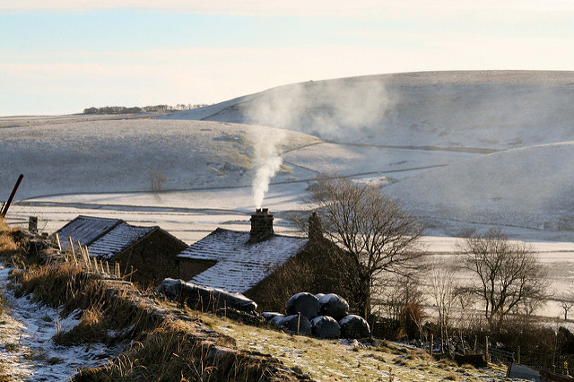
Macmillan Rural Health Outreach Service
Community based information and befriending support services for isolated rural residents, who are affected by cancer and other life limiting conditions
‘I was miserable, fed up and down, ready to give up. I wish I’d asked for help sooner.’
‘I valued the service my brother received, when you get older you don’t get many visitors. Apart from me and the Rural Outreach Service he had no other visitors.’

Slide 8
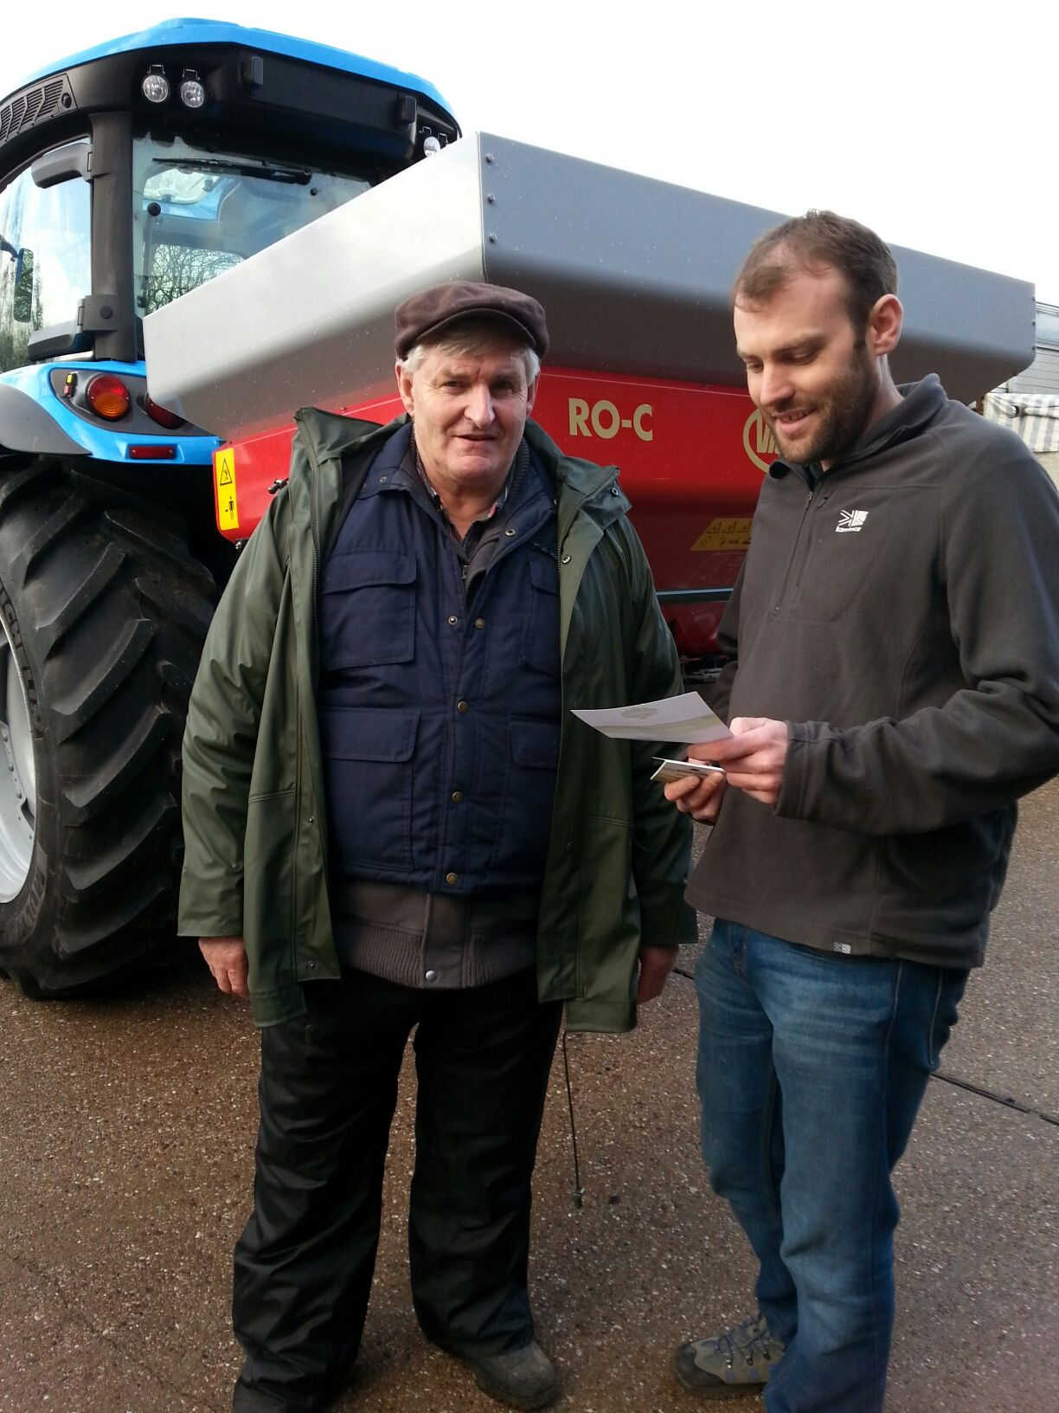
Peak District Farm Business Support Project
One to one support customised to individual farmers’ needs
Information and signposting to funding advice and support services
Topical workshops and networking events
Business mentoring and coaching

Slide 9
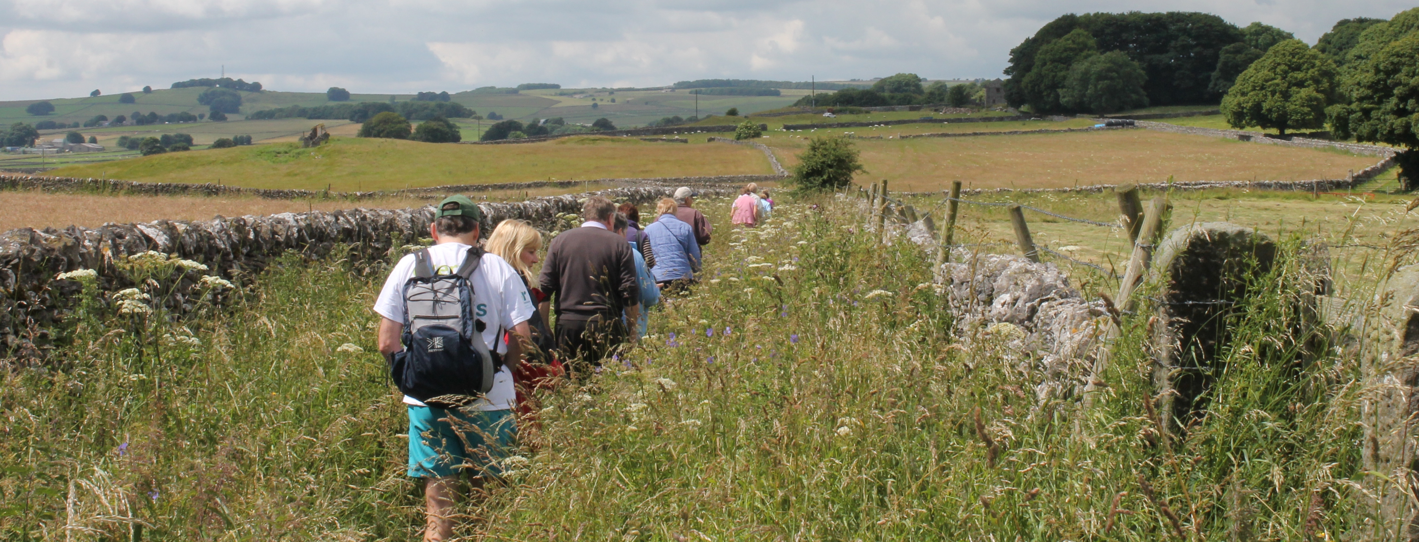
Rural Community Support activities
Rural social groups at the centre and at outreach locations – funded through North Derbyshire Clinical Commissioning Group
Walks for Health – Monthly walks with our trained walk leaders followed by tea and a chat
Rural craft and art groups
Community Cupboard – We have lots of equipment to share with our community
Working Closely with FCN, RAD, NFU, YFC and the Agricultural chaplaincy

Slide 10
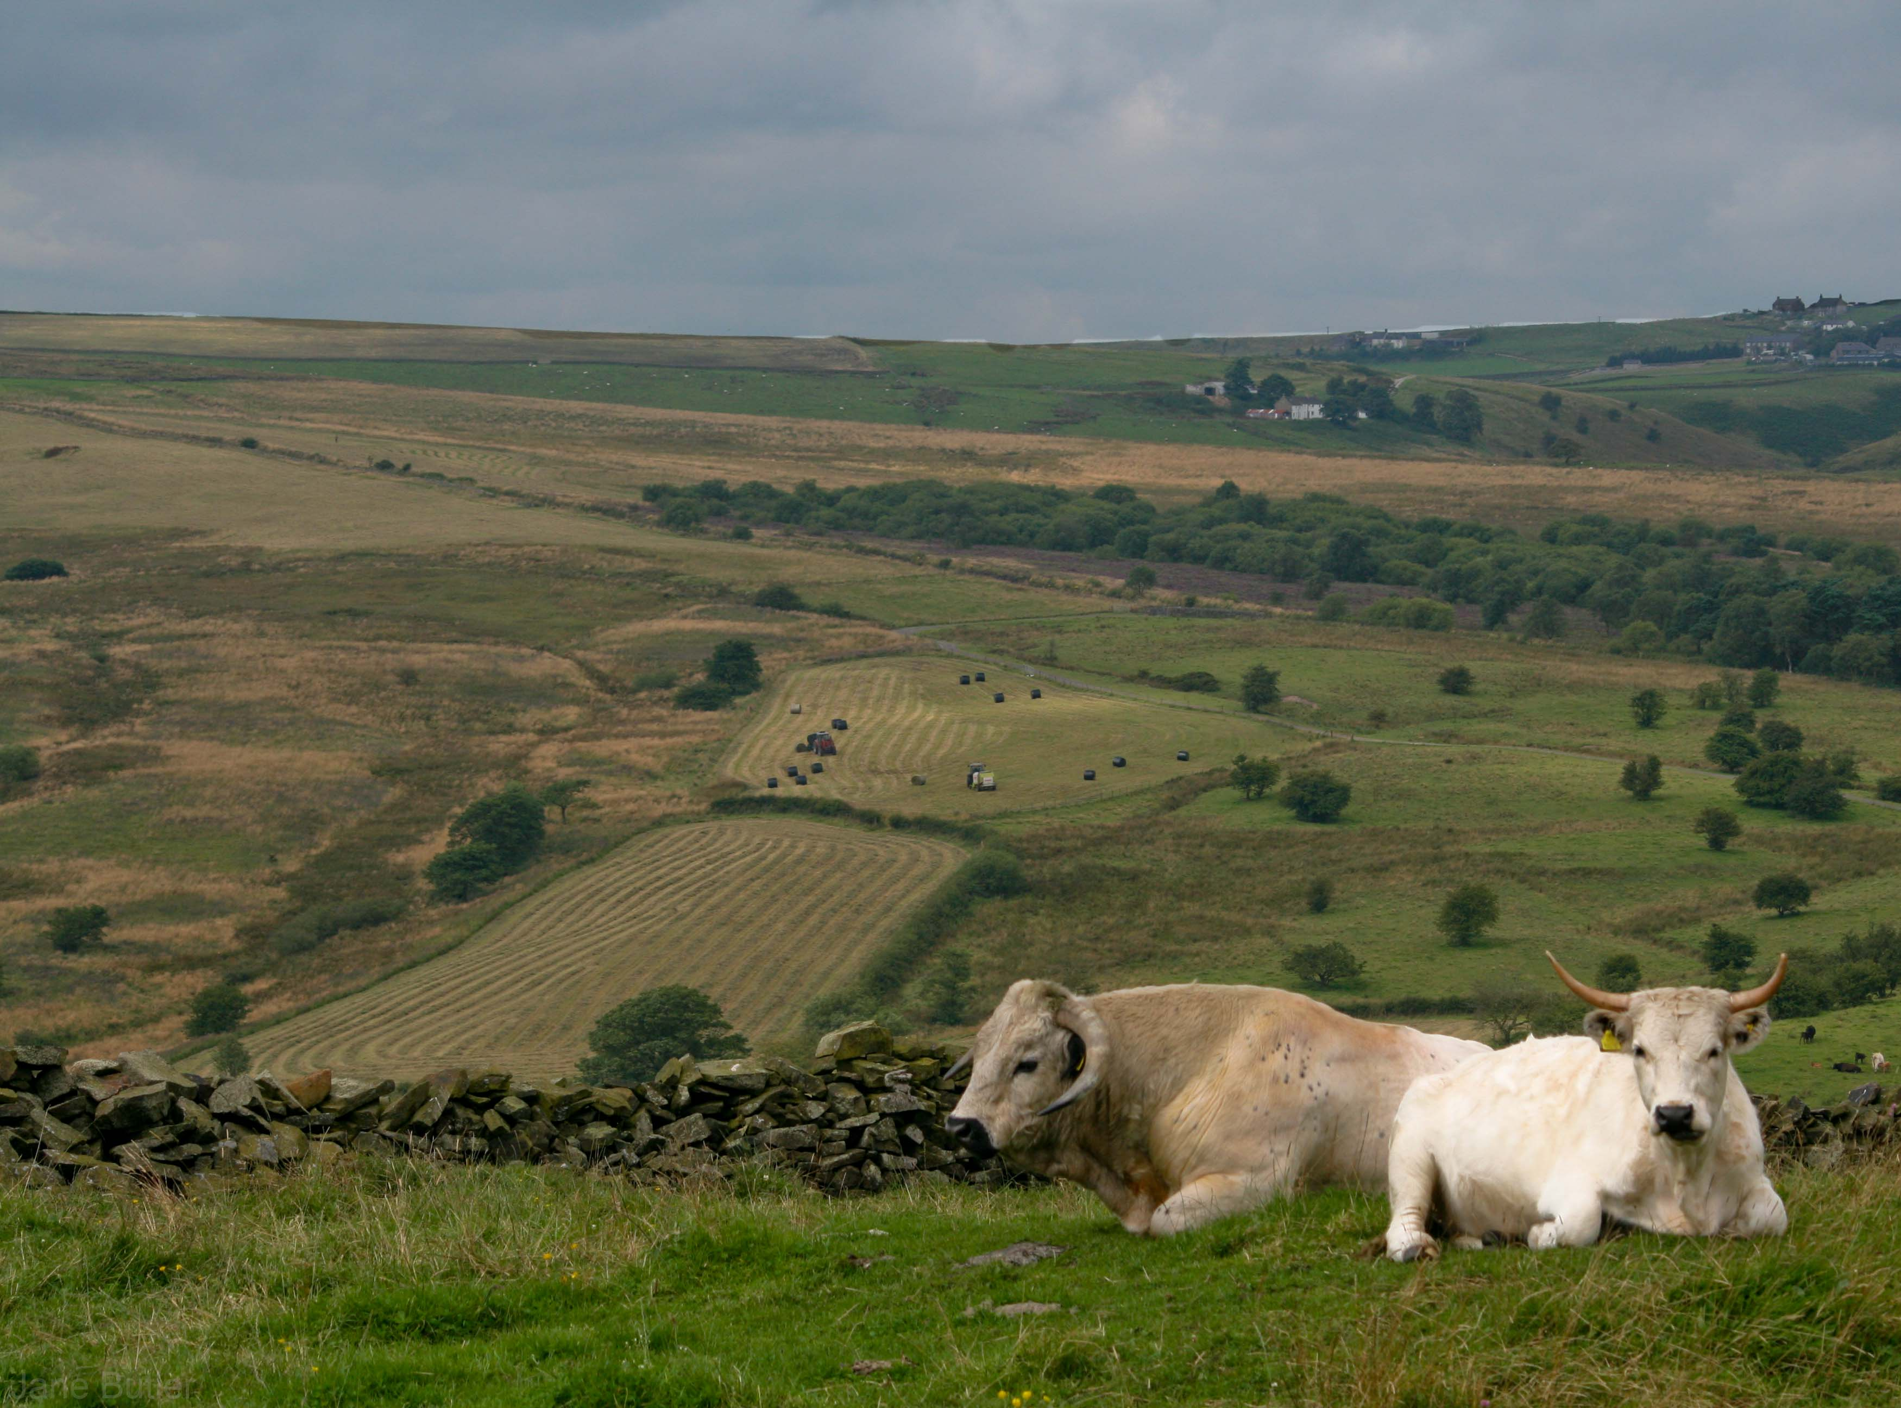
Other projects with partners
Catchment Sensitive Farming (Natural England)
Fresh Start Upland Academy
Peakland Lives, South West Peaks (Heritage Lottery Fund)

Slide 11
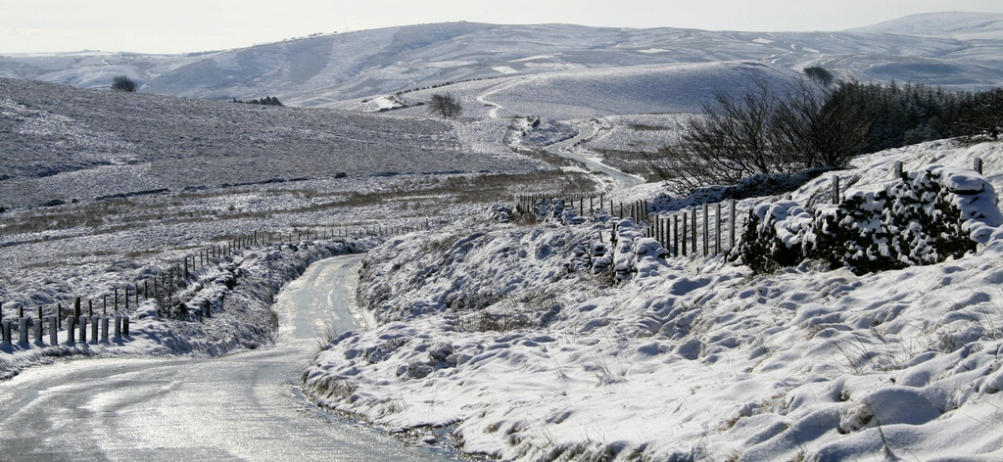
The view ahead
Continue to build community resilience
Extend our reach
To provide local facilities, a meeting place, training venue
To share our resources with our community

Slide 12
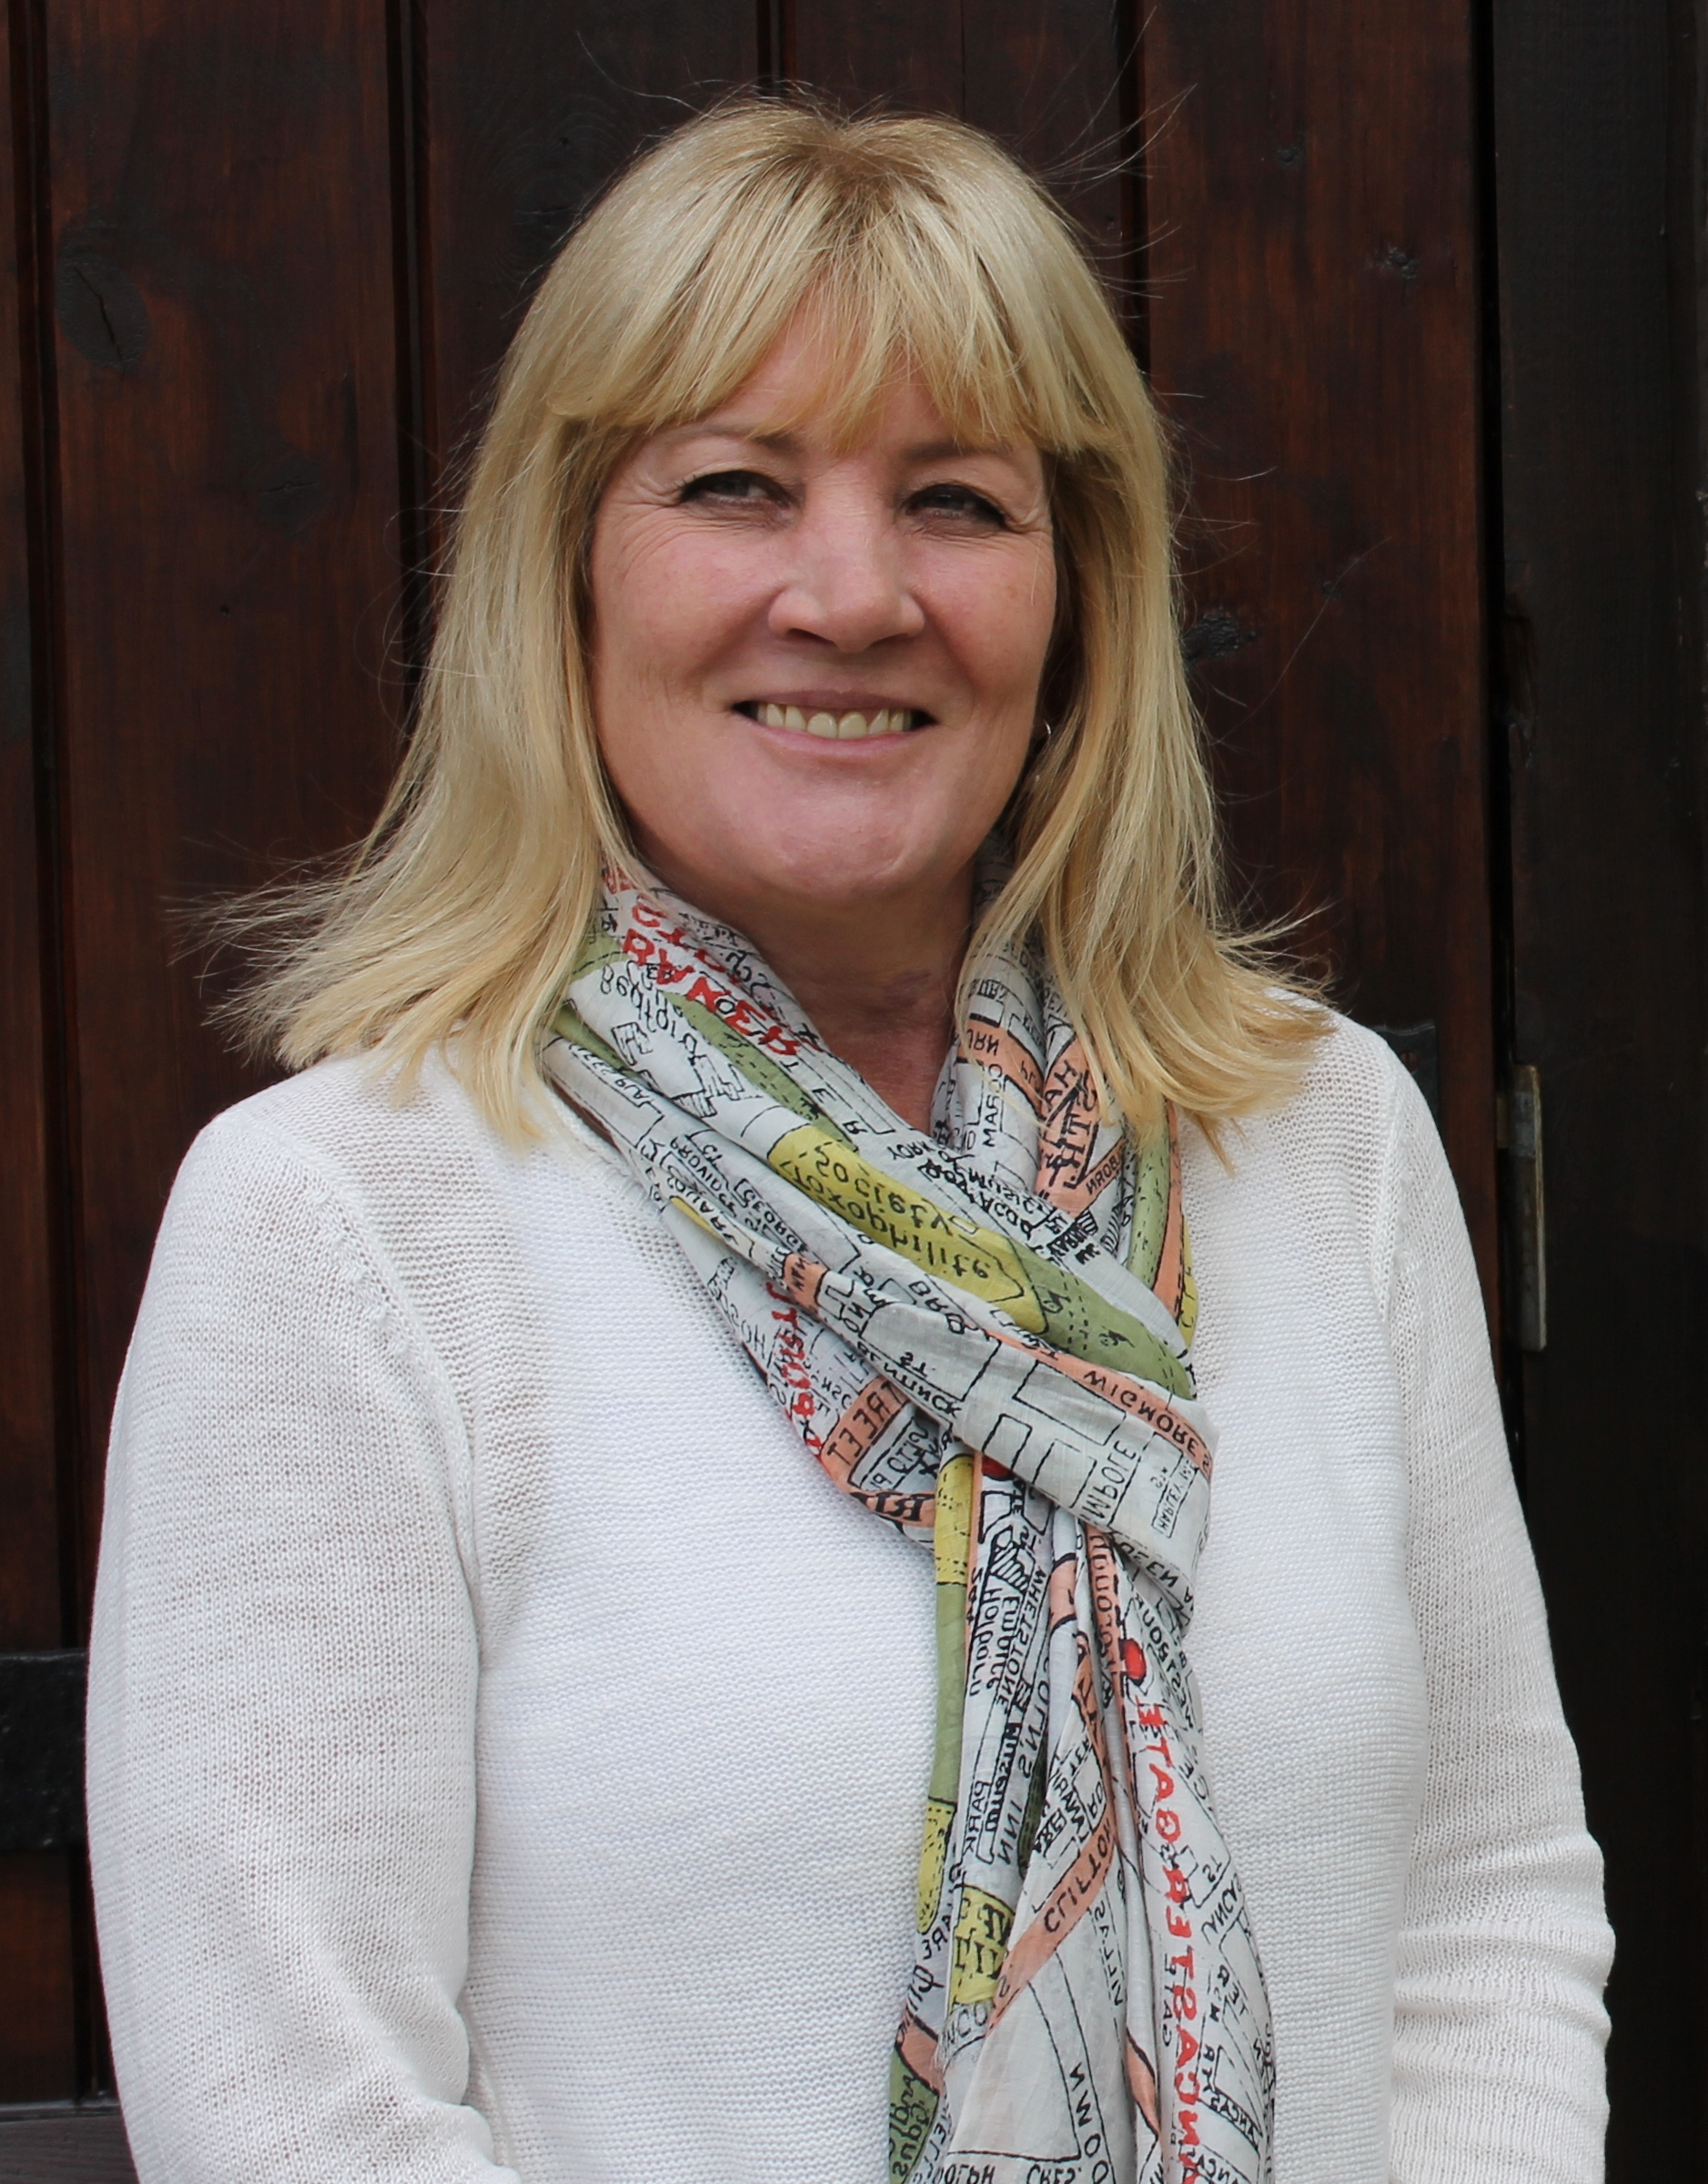
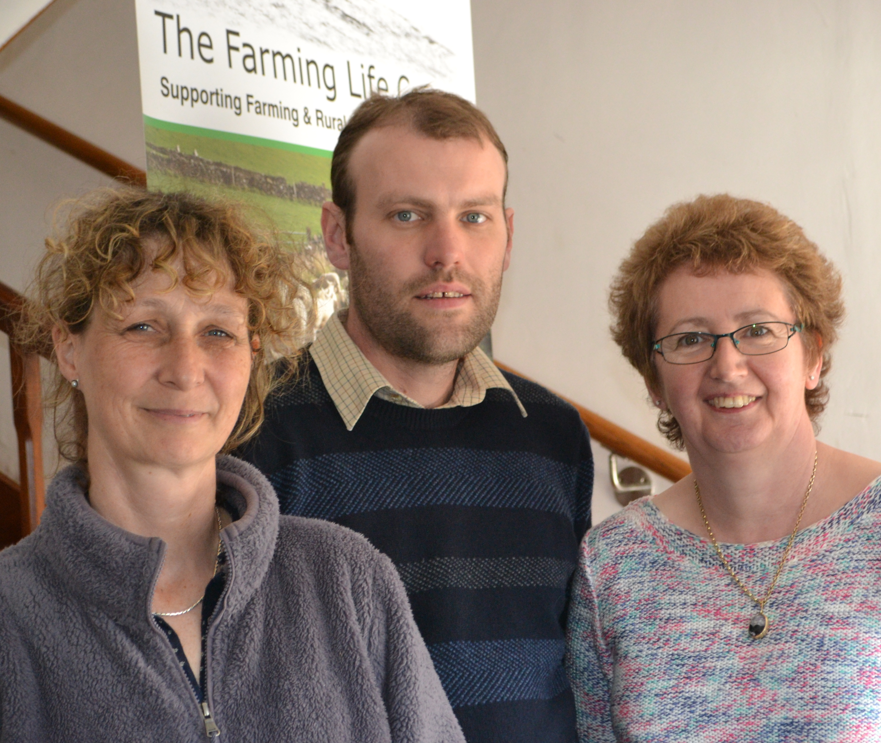
Working together
Catherine Stuart-Jervis Chief Executive Officer
Mary McNaught, Office Manager
Jonathan Charlesworth, Business Development
Jane Butler, Macmillan Rural Health
Karen Kidd Rural Social Groups Coordinator

